Slide 1

MINI PROJECT
RESTAURANT WEBSITE
Made By: Radhika Chopde
Reg.No.:22BCI0203

Slide 2

CONTENT
01
MOTIVATION
02
PROBLEM STATEMENT
03
SOLUTION
04
TECH TOOLS USED
05
RESULT

Slide 3

MOTIVATION
Accessibility and Convenience: A website makes the restaurant accessible to a wider audience by providing essential information such as location, hours, and menu online.also features like online reservations and ordering streamline the customer experience, saving time and effort.
Changing Consumer Behavior: Increasingly, consumers rely on digital platforms for dining needs, making a website essential for reaching them.
Learning Opportunity: Building a website hons skills in web development and design through real world application.

Slide 4
PROBLEM STATEMENT
Facilitating an online ordering service to provide customers with the convenience of placing orders from their residences.
Implementing an online hall booking system to accommodate events of varying scales, ensuring streamlined reservation processes for patrons.
Enhancing the dining experience by enabling customers to place food orders directly, eliminating the need to await waiter assistance for order placement.

Slide 5
SOLUTION
An online order page is incorporated into the website to enable customer to order food online from their resident.
An Events form is incorporated into the website to enable people to book hall online for any events they wish to conduct.
Inside the order online page dine in option is also incorporated so that the people don’t have to wait for the waiter to come and take order they can place their order online through website.

Slide 6
TECH TOOLS USED
HTML: HTML is the standard markup language for creating Web pages. It describes the structure of a web page.
CSS: CSS is the language we use to style a Web page. CSS describes how HTML elements are to be displayed on screen, paper, or in other media
JAVA SCRIPT: JavaScript is the programming language of the Web. It makes the webpages functional.

Slide 7
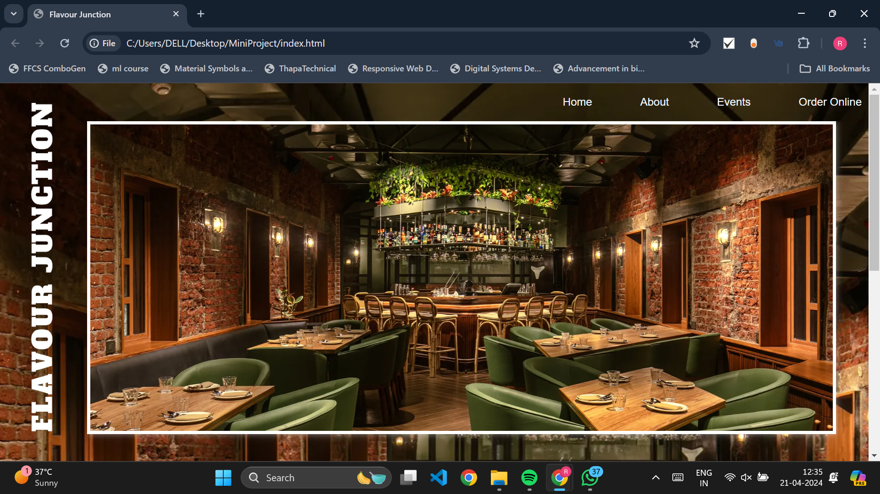
HOME PAGE

Slide 8
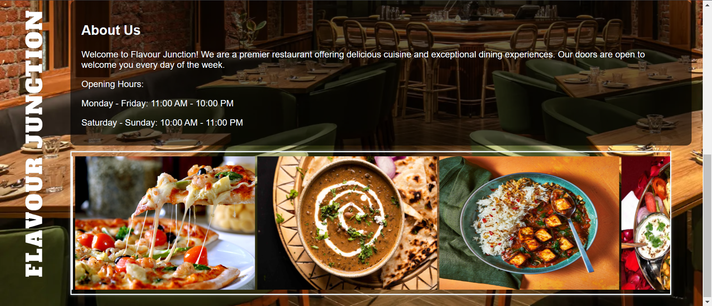
ABOUT

Slide 9
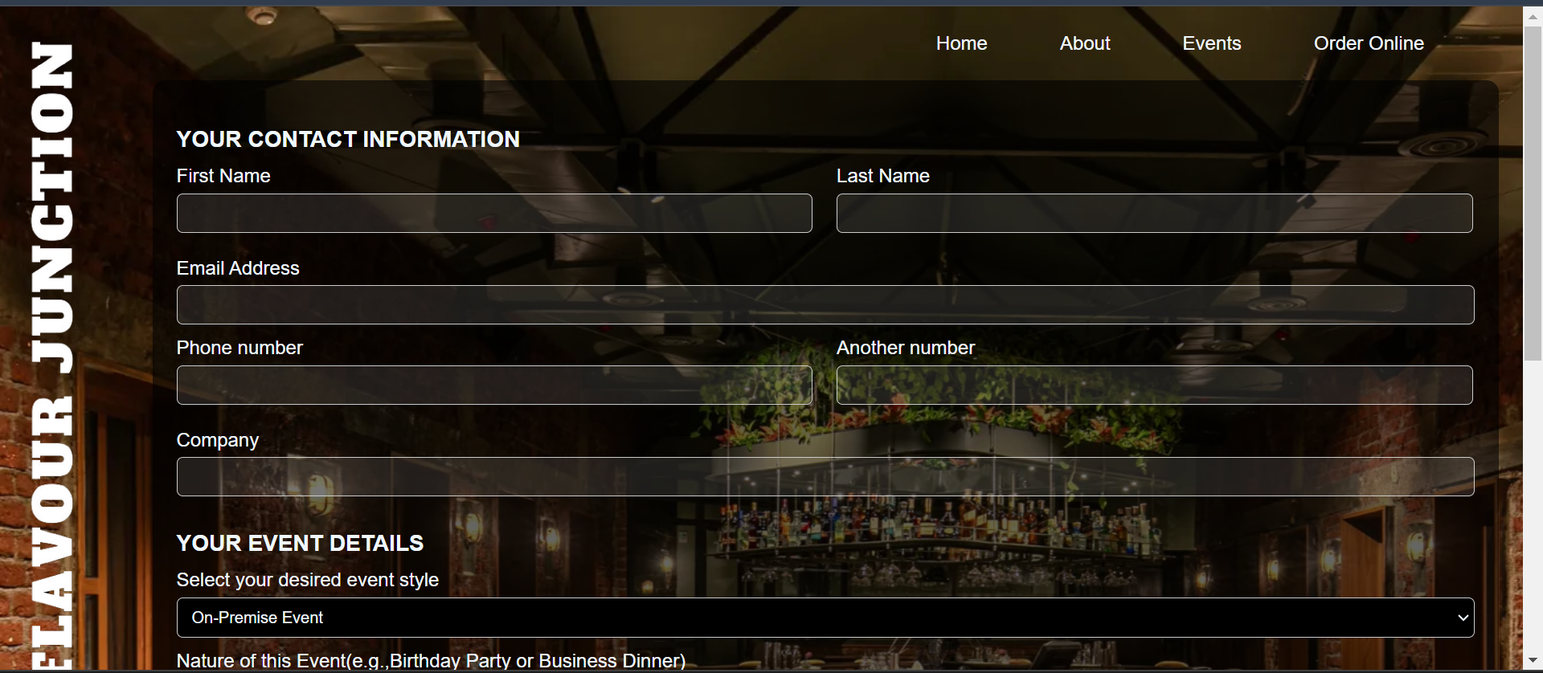
EVENTS

Slide 10
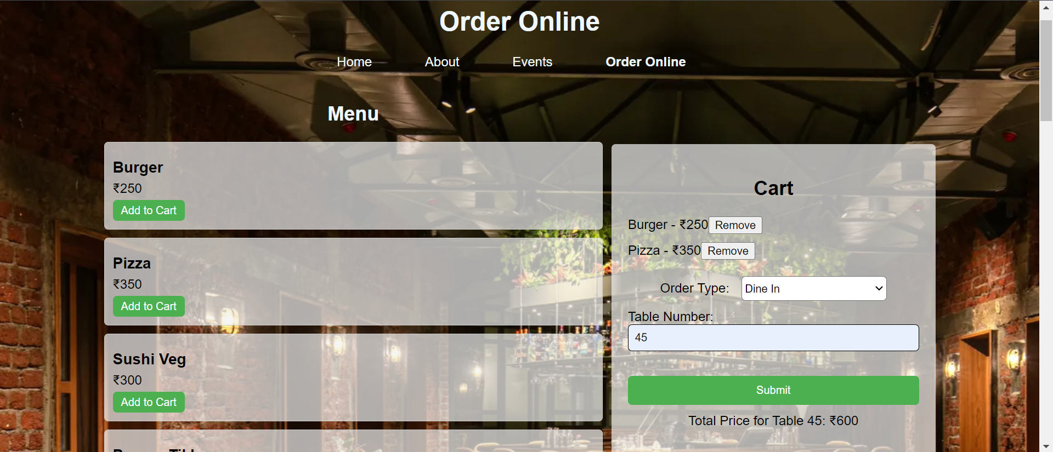
ORDER ONLINE(DINE IN)

Slide 11
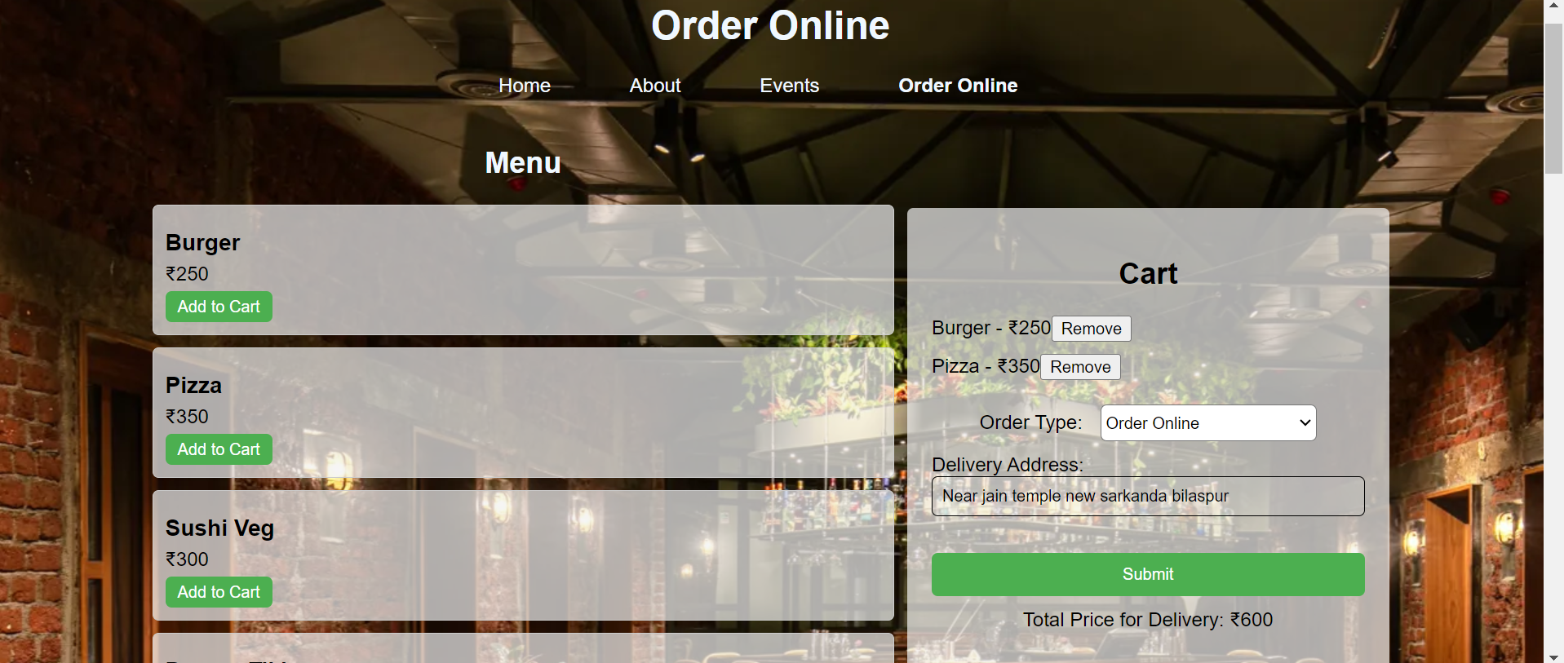
ORDER ONLINE

Slide 12


